Slide 1


Crew Leader
AND
Migrant Director Seminar
Region One Education Service Center
Migrant Education Program
January 24, 2018

Slide 2

Purpose
To establish communication between crew leaders, Texas Workforce Solutions, Region One Migrant Education Program and other agencies who work with migrant farm workers and students.

Slide 3
Objectives
To build relationships between different agencies;
To make connections with other agencies who may provide services to employers, agricultural workers, families, students;
To learn about services available to employers and families;
To provide services to agricultural workers and students;
To assist each other to better serve our agricultural workers and students;

Slide 4
Goal of the texas MEP
Post-Secondary and /or Employment Opportunities
Other Difficulties
Social Isolation
Cultural and Language Barriers
Mobility

Slide 5
Texas Migrant Eligibility
WHO
Children ages birth-21, who lack a U.S. issued high school diploma or Certificate of High School Equivalency within a 36 month period
WHERE
A move due to economic necessity from one residence to another residence; and from one school district to another school district.
WHAT
The kind of work, seasonal or temporary, that the worker was engaged in or actively sought

Slide 6
From Eligibility to Services
Identification and Recruitment (ID&R)
Recruiters and Reviewers
New Generation System (NGS)
Data Entry Clerks
Supplemental Services (Instructional & Support)
Support Staff, Directors, Principals, Counselors,
Strategists, Educators, Tutors

Slide 7
Instructional Versus Support Services
In order to meet the unique needs of migratory children, the MEP may provide two types of supplemental services:
  (1) instructional and (2) support
Instructional services are a direct service to assist in the attainment of education.
Support services are a tool and/or resource to assist with instructional goals or improve the quality of life.

Slide 8
Services
Texas Migrant Education Program is for children and not parents although parents are indirectly served through Migrant Parental Advisory Committees.
Examples of Instructional Services: Migrant Lab for remediation or credit recovery, A Bright Beginning Early Childhood Program, Tutoring, etc.
Examples of Support Services: Clothing, School Supplies, Tools for Homework Assistance, etc.

Slide 9
“If you want to go fast, go alone. If you want to go far, go with others.”
~African Proverb

Slide 10


Workforce solutions

Slide 11
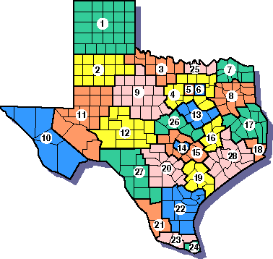
Workforce solutions
Workforce Solutions, under the direction of the Texas Workforce Commission, is the local workforce board that serves the Rio Grande Valley counties of Hidalgo, Starr, and Willacy.
Hours of Operation: Monday – Friday, 8:00 am – 5:00 pm

Slide 12
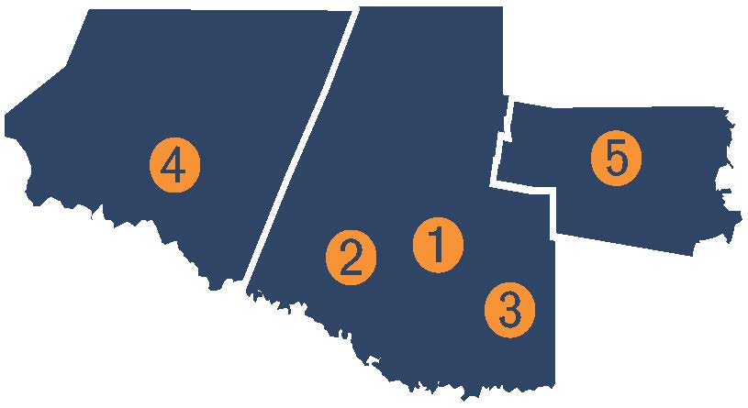
Workforce solutions
  WFS Edinburg Office
    2719 W. University Dr.
    (956) 380-0008
  WFS Mission Office
    901 Travis St., Ste.7
    (956) 519-4300
  WFS Weslaco Office
    1600 N. Westgate, Ste. 400
    (956) 969-6100
  WFS Starr County Office
  5408 Brand St., Ste. 1
  (956) 487-9100
  5. WFS Willacy County Office
    700 FM 3168, Ste. 3
    (956) 689-3412
    Toll Free: (877) 687-1121

Slide 13
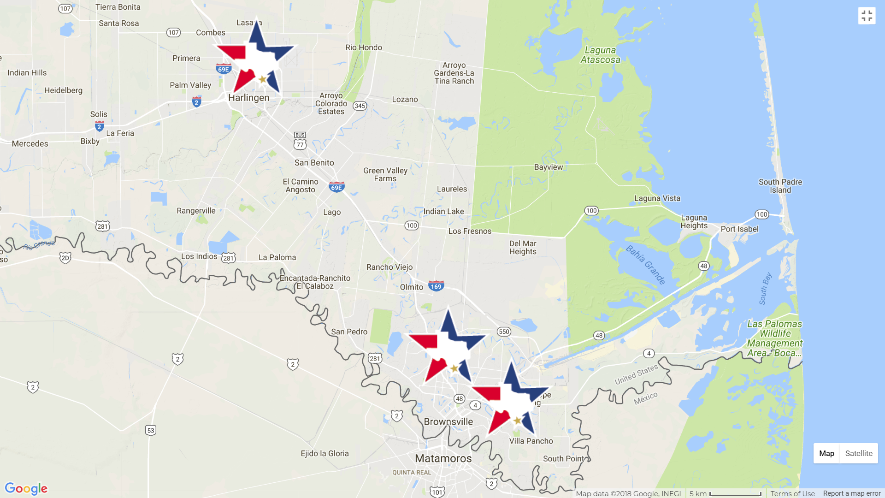
Workforce solutions CAMERON
  WFS Cameron
    601 E. Harrison Street
    Harlingen, Texas 78550
    (956) 423-9266
  WFS Cameron
    851 Old Alice Road
    Brownsville, Texas 78520
    (956) 546-3141
  WFS Cameron
    5636 Southmost Road
    Brownsville, Texas 78520
    (956) 621-3480

Slide 14
Workforce solutions
Services Offered
Resource Room
  Free access to computers, Internet, fax, printer, phone
Training Opportunities
  Educational training, paid Work Experience, On-the-Job-Training (OJT)
Financial Aid
  Potential assistance for sponsoring training and assistance with completing your Free Application for Federal Student Aid (FAFSA) application.
Career Counseling
  Discuss career and training opportunities
Job Matching
  Assistance creating a WorkInTexas.com profile
Target Populations
  MSFW, Veterans, Foster Youth, UI Claimants, and long-term unemployed

Slide 15
Workforce solutions
Additional Services
Referrals
  To other agencies for assistance like GED, ESL, Community Resources
Fidelity Bonding
  Assistance for at-risk job applicants
Support Services (based on eligibility)
  Assistance with transportation cost, rent/utilities, work equipment/gear
Child Care Assistance
  Cover the cost of child care expenses (Co-pay may apply)
Assessments
  Determine interest and skills set, Career Readiness
Workshops
  Resume writing, interviewing skills, basic computer skills, etc.

Slide 16
Workforce solutions
Trainings
The trainings sponsored by WFS are based on local business/employer needs.
Currently, WFS sponsors approximately 100 trainings, including but not limited to:
  Associates in Nursing (LVN/RN)
  Pharmacy Technician
  Truck Driver
  Combination Welder
  Electrician

Slide 17
Workforce solutions
MSFW Outreach workers
Mario Galvan (Edinburg)
956-467-9920
mario.galvan@twc.state.tx.us
Yesenia Garcia-Sandoval (Mission)
956-573-5660
yesenia.garcia-sandoval@twc.state.tx.us
Adrian Robles (Willacy)
956-742-9735
adrian.robles@twc.state.tx.us
Fidencia Vazquez (Weslaco)
956-746-7906
fidencia.vazquez@twc.state.tx.us
Jhobana A. Hinojosa (Mission/Starr)
956-342-4085 jhobana.hinojosa@twc.state.tx.us

Slide 18
Workforce solutions CAMERON
MSFW Outreach workers
Susie Marchan (Brownsville)
956-546-3141
Susie.marchan@twc.state.tx.us
Gilberto Mata (Harlingen)
956-423-9266
Gilberto.mata@twc.state.tx.us

Slide 19
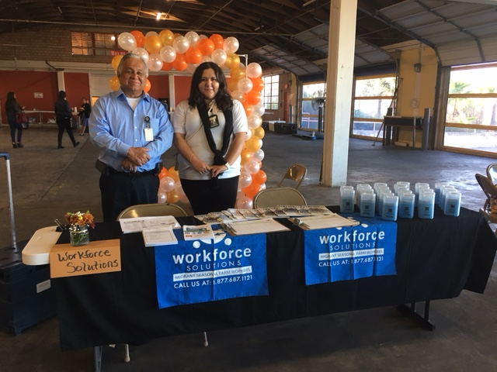
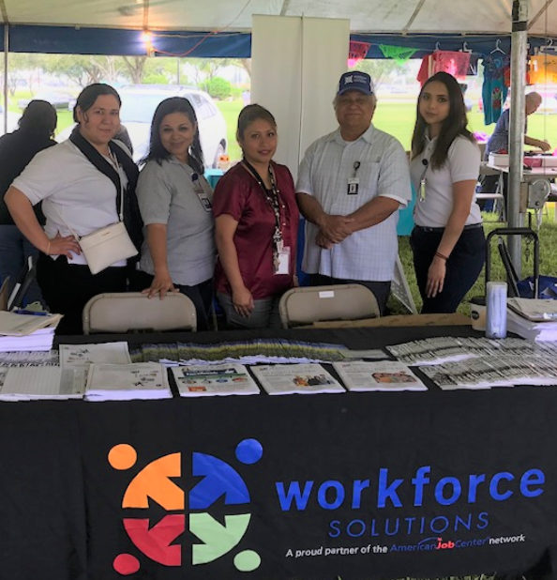
Workforce solutions

Slide 20
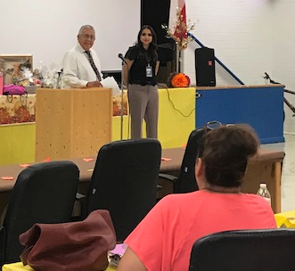
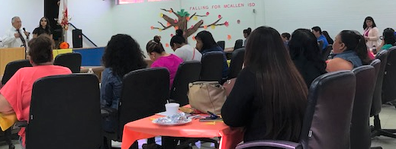
Workforce solutions

Slide 21
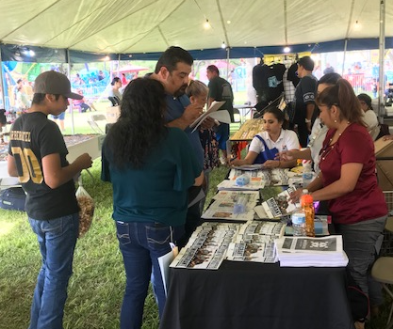
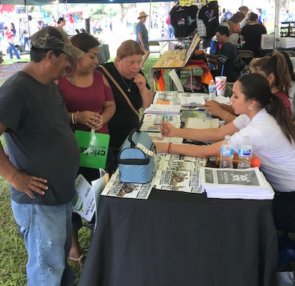
Workforce solutions

Slide 22




Workforce solutions
Contact WFS
E-mail: info@WFSolutions.org
Online: WFSolutions.org
Facebook: /RGVOP
Twitter: @WFSolutions

Slide 23
Round-Table Discussion

Slide 24

What is your name and title? Can you describe the type of work you do?

Slide 25
What type of work/employer do you recruit for? Do you recruit families or men only?
How many families/men do you normally recruit?
Do you work with the same families/men year after year?

Slide 26
What locations do you work and when?
How long does the work last?
(months/weeks?)

Slide 27
Are there resources or organizations close to the work or living area?
Do you partner with these organizations to assist the families you recruit?

Slide 28
Are you aware of any educational programs in your area of work?

